Slide 1
Achieving Cross Sector Collaboration through Collaborative Modeling
Antonie J. Jetter
Portland State University
ajetter@pdx.edu

Slide 2
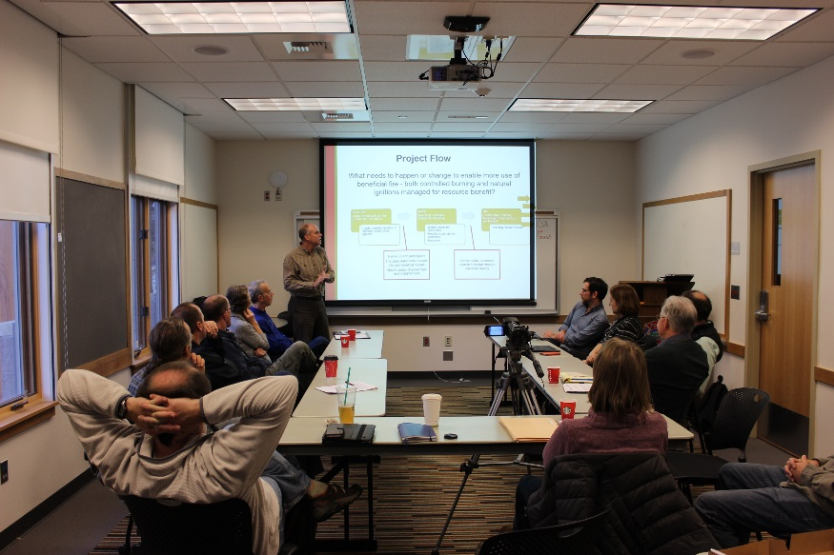
Collaborative Modeling
Systems modeling techniques ...
... used to adress complex social and environmental problems
... in a particpatory fashion
... so that individuals/communities can understand and change a system

Slide 3
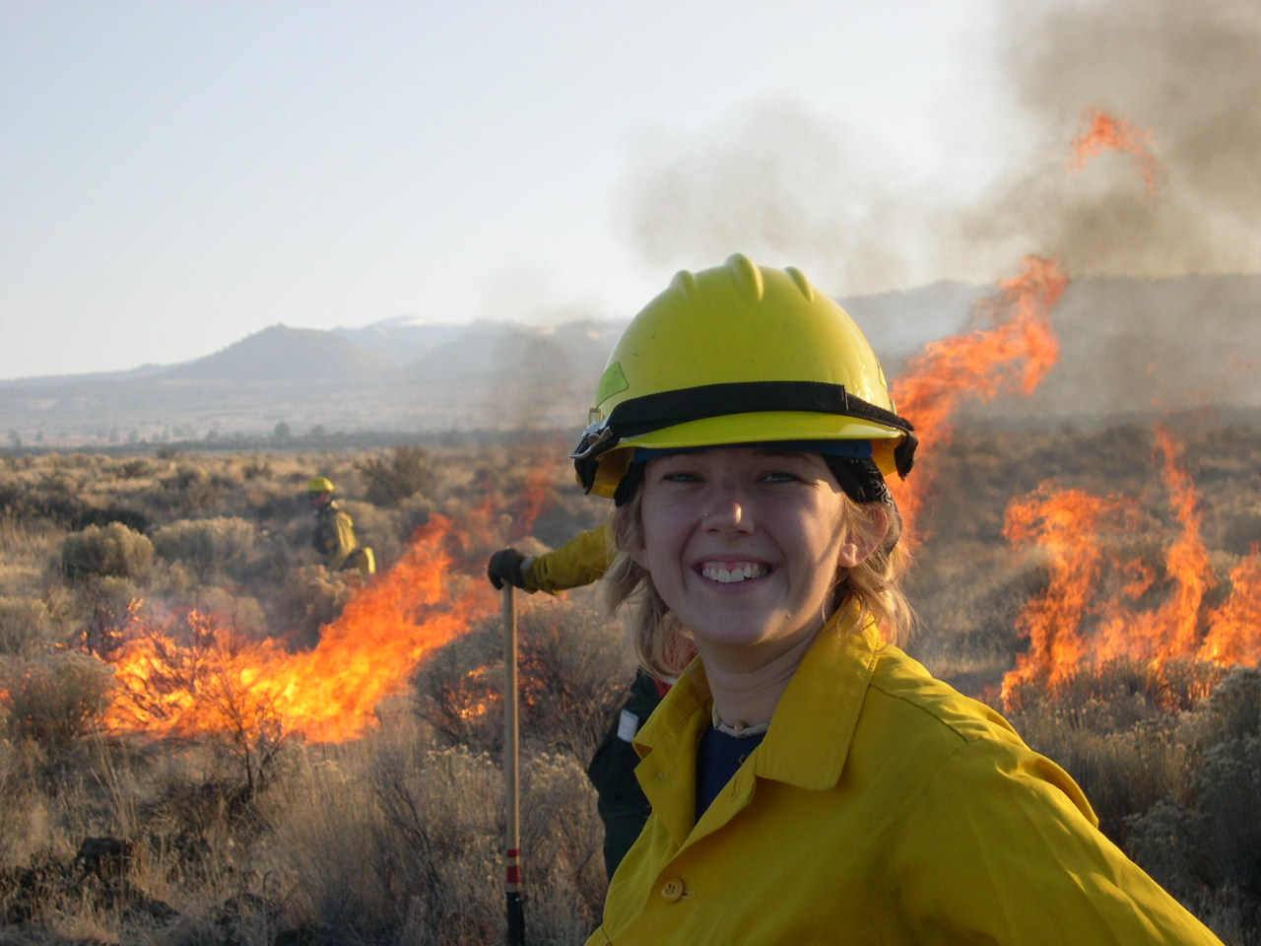
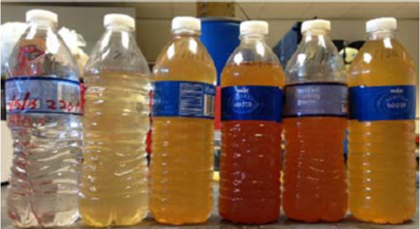
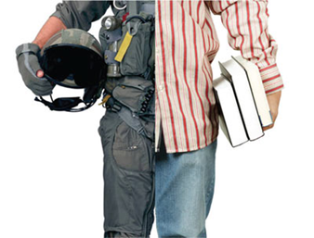

Slide 4
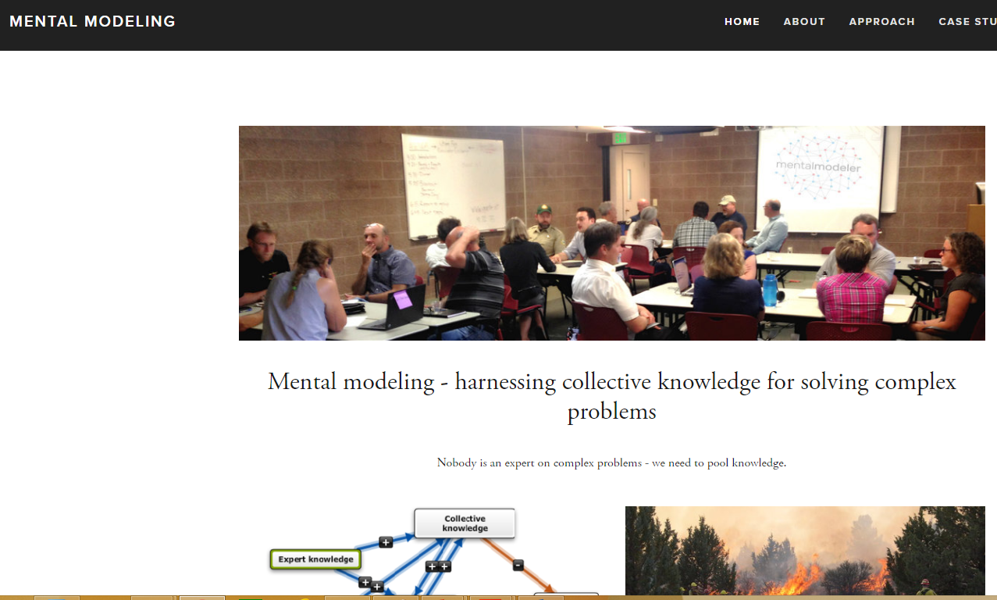
Modeling with Fuzzy Cognitive Maps
www.mentalmodeler.org (software)
www.mentalmodeling.org (cases and applications)

Slide 5
Cognitive Maps
Collections of beliefs, experiences, and information that people uses to orient themselves within an environment such as a social setting
consist of concepts and relationships between them
subjective worldviews, not necessarily “true”
… but informed by facts, scientific and traditional knowledge, experiences, observations
… and used to make decisions
can be visually represented

Slide 6
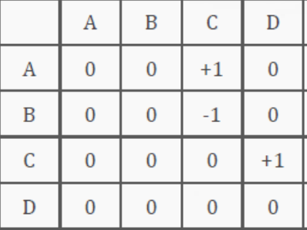
A simple Cognitive Map

Slide 7
Activating (turning on) concepts

Slide 8
Innovation: Fuzzy Cognitive Maps
Make cognitive maps computable → simulate outcomes of changing system elements
System modeling:
use qualitative and quantitative information
open structure that can be easily extended
relatively “simple“ and intuitive

Slide 9
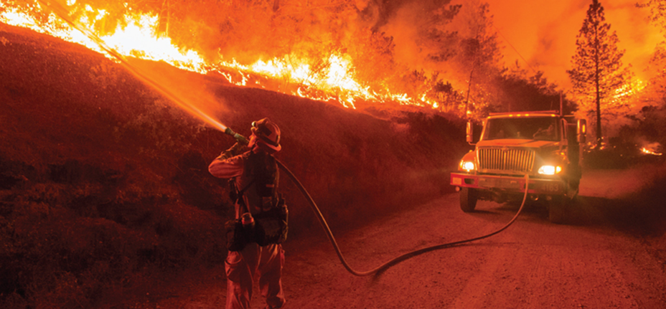
EXAMPLE
Antonie Jetter, Pei Zhang, Oussama Laraichi Portland State University
Steven Gray, Alison Singer, Degen Gembarowski, Michigan State University
Lisa Ellsworth, Oregon State University

Slide 10
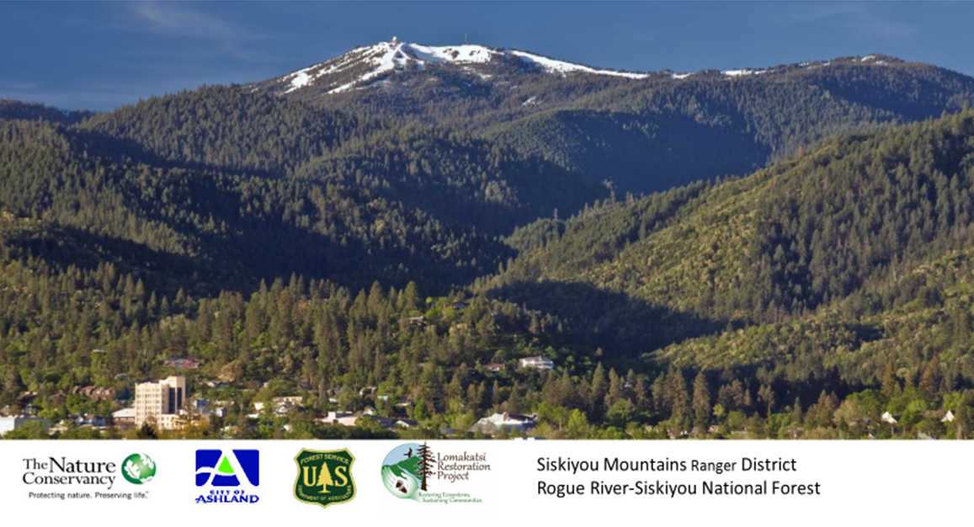
Bringing Back Fire...

Slide 11
Fires in the West

Slide 12
“Bringing BACK Fire” Initiative
Convene a series of facilitated community listening sessions, focus groups, and/or shared learning and planning workshops …
… enabling the community to collaboratively address barriers and reach agreements
… which define a fire management plan embracing “right fire” and informing the agency Wildland Fire Decision Support System

Slide 13
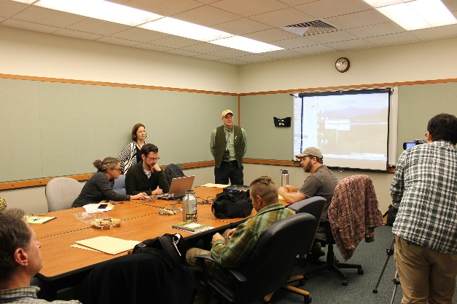
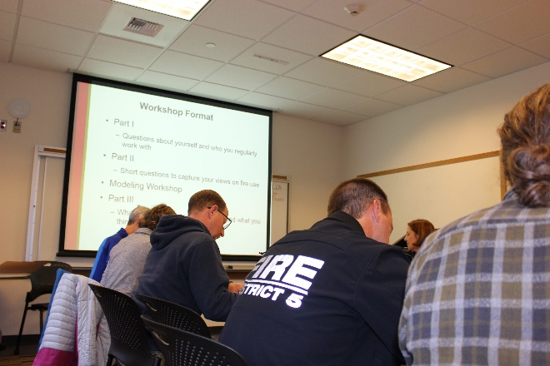
Study Sites: 7 Workshops
City of Ashland Government and Business Leadership (6 participants)
Conservationists resistant to active management in favor of allowing all natural fire (3 participants)
Fire managers from the Oregon Department of Forestry and the Medford District Bureau of Land Management (8 participants)
Local private forest and woodland owners (7 participants)
Fire managers River-Siskiyou National Forest (4 participants)
Conservationists accepting active management and 2 participants from the 2nd workshop (4 participants)
All stakeholder knowledge exchange (with participants from all workshops, but conservations, 17 participants)

Slide 14
Example Cognitive Map
“People push into formerly uninhabited areas, and more structures and people are exposed to the risks of natural wildland fires. Also, incidents of accidental fire go up because power lines are strung through former wildlands and people operate machinery. Better education on defensible space helps to minimize the harm to property and people, but there will be more fires and our overall risk will increase.”

Slide 15
Example FCM Simulation

Slide 16
Testing Policies– here: Improved Education on Defensible Space
Drops from 0.94 to 0.64
Remains at 0.76

Slide 17
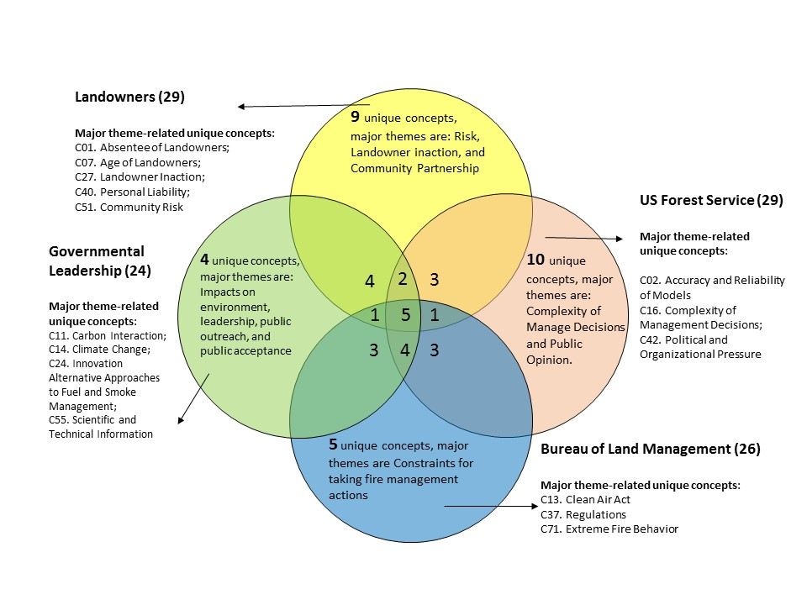

Slide 18
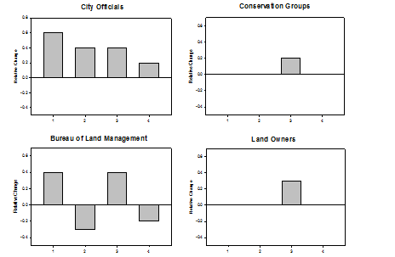
Understanding Policy Preferences

Slide 19
Brainstorming Solutions (examples)
Smoke & culture surrounding smoke
With regard to air quality, regulate prescribed burns like wild fire
Community-level initiatives (“Burn block party”)
More technical information to the public so that they understand the logic of burn operations and are less fearful
Change mop-up practice after prescribed fire to model that “zero fire” is not necessary to be safe
Prompt public notice when a prescribed burn is approved
Risks
Mitigating fuel loads
Better management of controlled fires especially natural ignition

Slide 20
Using the analysis for making managerial recommendations
Decision-makers should …
Emphasize effective risk communications - in addition to ecosystem knowledge → different brochures, videos, …
Decrease uncertainty regarding risk assessments → better scientific models
Consider emphasizing larger scale efforts → Rogue River Basin, not just Ashland

Slide 21
Recap and pointers…

Slide 22
Modeling a System
Consists of elements that influence each other: whatever you do, you always impact more than one thing
Have a function or purpose
Have behaviors (goal-seeking, evolutionary, adaptive, self-preserving…)
Therefore….
Look for feedback loops
Look for concepts with only one out-arrow: do they really only impact one concept?
Look for concepts with only one in-arrow: does the concept really only depend on one concept?

Slide 23
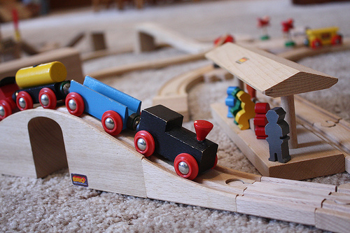
Why model?
Model = Simplification of the “real world” …
… for a particular purpose
… incomplete, simple, (“wrong”), but useful
Allows us to try things we cannot (easily) do in the real world:
If I do X …. what happens to Y? Does anything else happen that is interesting to me?
What gets the better result – Action A or Action B?
(thus, we run scenarios (simulations): what would happen in the real world?)

Slide 24
Why model collaboratively?
Pooling of knowledge (traditional knowledge, stakeholder experiences, academic experts, …)
“Because it is the right thing to do” (equity, democracy, …)
To create buy-in and build capacity to change things
Your main objective may change throughout your project!

Slide 25
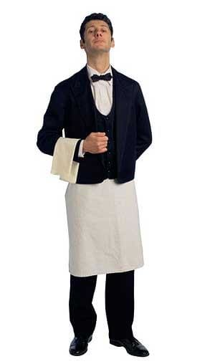
We model causality
“Something changes because and after something else changes”
Good Service
+
Tip
Price of dessert
-
# of people ordering dessert

Slide 26
We model to Pool Knowledge / Cognitive Maps and simulate
First:
Capture individual mental models
Then:
Combine individual mental models to create a holistic model of the system for the purpose of simulation
→ it is OK (important) to interpret and aggregate

Slide 27
It is a process!

Slide 28
Contact
Antonie J. Jetter
Department of Engineering and Technology Management
Portland State University
ajetter@pdx.edu
https://scholar.google.com/citations?user=fx_AW4cAAAAJ&hl=en

